Slide 1

CLINIC MANAGEMENT SYSTEM DATABASE PROJECT
prepared by : shahd sameh safwat
ID: 231002256
submitted to : doc.mohamed elsayeh

Slide 2

OVERVIEW
This project is a Clinic Management Database System designed using SQL to manage doctors, patients, departments, and appointments

Slide 3
PROBLEM STATMENT
Manual clinic management causes:
Errors in scheduling
Data duplication
Difficulty in tracking patients and doctors

Slide 4
SOLUTION
I designed and implemented a relational database system using SQL to manage clinic operations efficiently.
Key Improvements:
Centralized storage of all clinic data
Reduced data redundancy and errors
Improved appointment scheduling accuracy
Easy retrieval of patient and doctor information

Slide 5
SOLUTION
System Includes:
Tables (Doctors, Patients, Clinics, Departments, Appointments)
Views for better data analysis
Triggers to maintain data integrity
SQL queries for data manipulation
This system improves efficiency, accuracy, and organization in clinic management

Slide 6
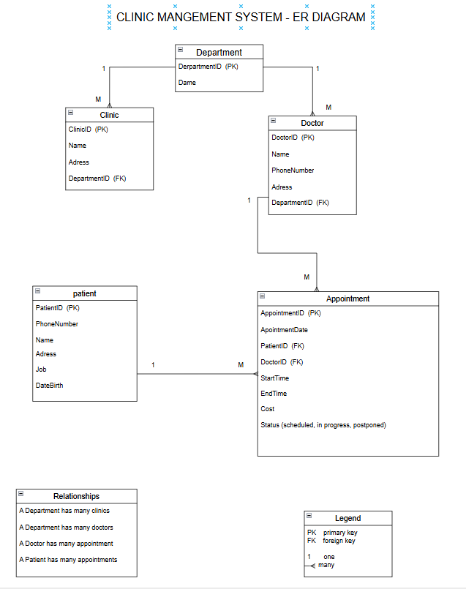
ER DIAGRAM
Represents relationships between all entities in the systems
Main entities:
Doctors
Patients
Clinics
Department
Appointments
The ER diagram helps visualize how data is connected and structured in the database

Slide 7
DATABASE TABLES
The system consists of the following main tables:
Department → stores clinic departments
Doctor → stores doctor information and specialization
Patient → stores patient personal data
Clinic → stores clinic details
Appointment → manages booking between doctors and patients
Each table is connected using primary and foreign keys to maintain relationships.

Slide 8
SAMPLE SQL QUERIES
Purpose:
Retrieve all doctors in a specific department
Show all upcoming appointments
List patients with their doctors
Count number of appointments per doctor
To demonstrate data retrieval and system functionalit

Slide 9
VIEWS
A view is a virtual table used to simplify complex queries.
Benefit:
Makes data easier to read
Saves time in writing repeated queries
Improves data analysis

Slide 10
TRIGGERS
A trigger is an automatic SQL action executed when a specific event occurs.
Example:
Prevents overlapping appointments for the same doctor
Benefits:
Maintains data consistency
Prevents scheduling conflicts
Reduces human errors

Slide 11
THE USER INTERFACE
UI Bonus
I created a user interface and working application to make it easier to book an appointment and avoid the overlapping between doctors and dates
And now I will give a quick demo

Slide 12
CONCLUSION
The ClinicDB system provides an efficient solution for managing clinic operations.
Key Benefits:
Improved data organization
Reduced manual errors
Faster and more accurate appointment management
The system demonstrates how databases can improve real-life healthcare management.

Slide 13
THANK YOU

